Slide 1
Workshop in experimental design and applied statistics: Day 1
Curriculum and educational materials developed by Maegen Simmonds
Agricultural Field Trial Statistics App developed by Ian King Kyle, Jason Moore, and Maegen Simmonds Funded by USAID and CYMMYT
This work is licensed under a Creative Commons Attribution 4.0 International License, which encourages you to remix and reuse. Give credit where credit is due.
Notes:
This is a course for agronomists and animal scientists

Slide 2
Workshop Goals
To understand experimental design and principles of statistical analysis to produce trustworthy results and interpretations.
To learn how to use the free Agricultural Field Trial Statistics App to analyze and visualize your data

Slide 3
Workshop Goals
What do YOU want to learn?
Write down 3 of your goals and we will create a list of your top priorities for the whole group
Notes:
Instructor can record top goal for each person on a board and ask others for any other goals not mentioned.

Slide 4
What are we doing today?
Instruction 9:00 – 11:00 AM
Introductions
Section 1: Experimental design, ANOVA, hypothesis testing
Tea break 11:00 – 11:30 AM
Instruction 11:30 – 1:00 PM
Section 2: Agricultural Field Trial Statistics App
ANOVA and interpretation with 1 treatment and with 2 treatments, factorial
Lunch 1:00 – 2:00 PM
Instruction 2:00 – 2:30 PM
Tea break 2:30 – 3:00 PM
Instruction 3:00 - 4:00 PM

Slide 5
What basic experimental designs do you use in your research?
Examples:
Complete Randomized Design
Randomized Complete Block Design
Split-plot Design
What about a “Factorial”?
A factorial is a treatment structure for any of the experimental designs above when there are 2 factors (or more) being tested and all possible combinations of treatment levels.

Slide 6
Overview of experimental setups covered in this workshop and that can be analyzed with the App:
Experimental Design | What is it? | Number of factors? | Number of treatment levels? | Number of study sites
Complete Randomized Design (CRD) | Treatments randomly assigned to experimental units without grouping | 1 or 2 factors (e.g. nitrogen rate and/or variety) | Unlimited (e.g. 4 levels of fertilizer rates: 0, 50 150, 200 kg/ha) | Unlimited
Randomized Complete Block Design (RCBD) | Treatments are randomly assigned to experimental units within groups (blocks) | 1 or 2 factors | Unlimited | Unlimited
Split-plot design | Two levels of randomization, at the main-plot and sub-plot level. | 2 factors | Unlimited | Unlimited
Notes:
Notice difference in each experimental design is about how you randomize treatment assignments.

Slide 7
Section 1 Learning Objectives
You will gain a basic understanding of:
Elements of an experiment
Complete Randomized Design (CRD)
Hypothesis testing
Principles of Analysis of Variance (ANOVA) for a CRD with one treatment
Elements in an ANOVA table for a CRD with one treatment

Slide 8
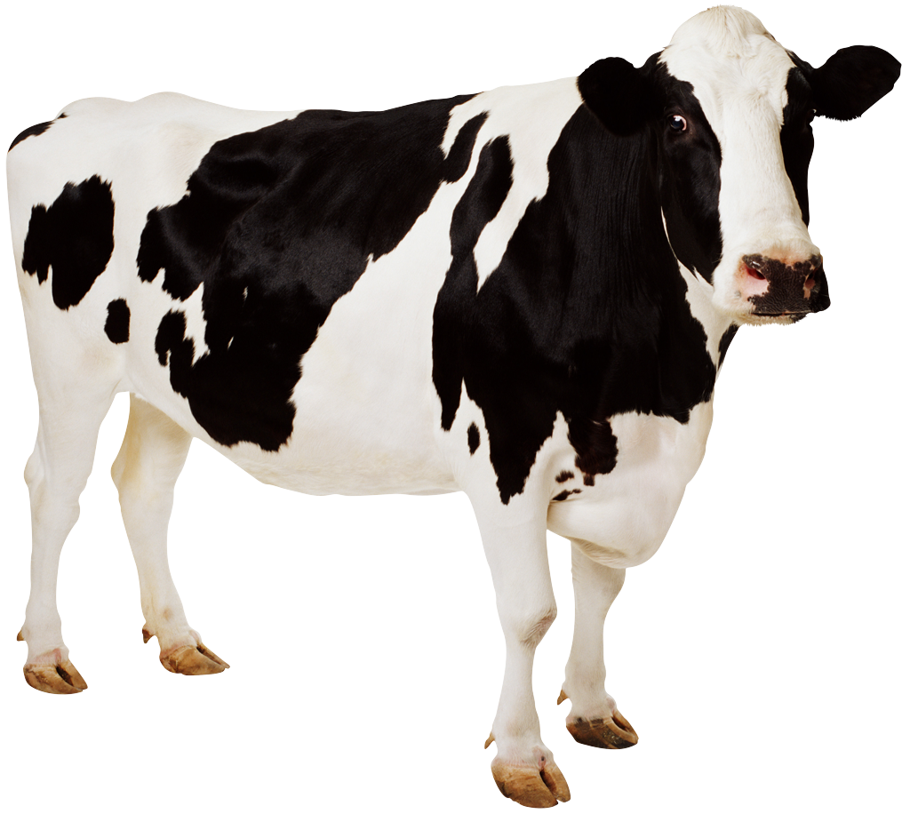
Research question: Is there an effect of milking practice on milk production performance in Sahiwal cows? Four milking practices: (1) hand-milk 2x/day (2) hand-milk 3x/day (3) machine-milk 2x/day (4) machine-milk 3x/day
Cow
What is the experimental unit?
Notes:
CRD may be appropriate because experimental units are similar.

Slide 9
Research question: Is there an effect of milking practice on milk production performance in Sahiwal cows? Four milking practices: (1) hand-milk 2x/day (2) hand-milk 3x/day (3) machine-milk 2x/day (4) machine-milk 3x/day
Cow
What is the experimental unit?
What is the dependent variable?
Milk production performance
Notes:
CRD may be appropriate because experimental units are similar.

Slide 10
Research question: Is there an effect of milking practice on milk production performance in Sahiwal cows? Four milking practices: (1) hand-milk 2x/day (2) hand-milk 3x/day (3) machine-milk 2x/day (4) machine-milk 3x/day
Cow
What is the experimental unit?
What is the dependent variable?
What is the independent variable?
Milk production performance
Milking practice
Notes:
CRD may be appropriate because experimental units are similar.

Slide 11
Research question: Is there an effect of milking practice on milk production performance in Sahiwal cows? Four milking practices: (1) hand-milk 2x/day (2) hand-milk 3x/day (3) machine-milk 2x/day (4) machine-milk 3x/day
Cow
What is the experimental unit?
What is the dependent variable?
What is the independent variable?
Milk production performance
Milking practice
How many factors are
there?
One (Milking practice)
Notes:
Could also say there are two factors: milking method and milking frequency. But we are combining them here.

Slide 12
Research question: Is there an effect of milking practice on milk production performance in Sahiwal cows? Four milking practices: (1) hand-milk 2x/day (2) hand-milk 3x/day (3) machine-milk 2x/day (4) machine-milk 3x/day
Cow
What is the experimental unit?
What is the dependent variable?
What is the independent variable?
Milk production performance
Milking practice
How many factors are
there?
How many treatment levels?
One (Milking practice)
Four
Notes:
Could mention that milking practice can also be analyzed as 2 factors (milking type & frequency) with factorial treatment structure because ALL treatment levels are combined (2 x 2 = 4).

Slide 13
Research question: Is there an effect of milking practice on milk production performance in Sahiwal cows? Four milking practices: (1) hand-milk 2x/day (2) hand-milk 3x/day (3) machine-milk 2x/day (4) machine-milk 3x/day
1. What experimental design would you use to determine if there is an effect of milking practice on milk production (kg)?
We are choosing to randomly assign the 4 treatments to 12 of these cows.
What experimental design is this called? How many replications do we have?

Slide 14
Research question: Is there an effect of milking practice on milk production performance in Sahiwal cows? Four milking practices: (1) hand-milk 2x/day (2) hand-milk 3x/day (3) machine-milk 2x/day (4) machine-milk 3x/day
This type of experimental design is called a Complete Randomized Design (CRD) (no blocking)
With 4 treatments and 12 total cows, we have 3 replications. How do we assign treatments?
12 representative cows are randomly selected,

Slide 15
Research question: Is there an effect of milking practice on milk production performance in Sahiwal cows? Four milking practices: (1) hand-milk 2x/day (2) hand-milk 3x/day (3) machine-milk 2x/day (4) machine-milk 3x/day
This type of experimental design is called a Complete Randomized Design (CRD) (no blocking)
With 4 treatments and 12 total cows, we have 3 replications. How do we assign treatments?
12 representative cows are randomly selected,
And 4 treatments (3 reps) are randomly assigned to the 12 cows.

Slide 16
Research question: Is there an effect of milking practice on milk production performance in Sahiwal cows? Four milking practices: (1) hand-milk 2x/day (2) hand-milk 3x/day (3) machine-milk 2x/day (4) machine-milk 3x/day
This type of experimental design is called a Complete Randomized Design (CRD) (no blocking)
With 4 treatments and 12 total cows, we have 3 replications. How do we assign treatments?
12 representative cows are randomly selected,
And 4 treatments (3 reps) are randomly assigned to the 12 cows.
Notes:
Explain that once the cows receive the treatment the assigned treatments to each cow will not change.

Slide 17
Before looking at the milk production measurements, let’s discuss replications versus subsamples

Slide 18
Questions to ask yourself to determine if you have replications or subsamples:
What is your experimental unit?
The object or subject that was randomly assigned a treatment
Examples from your research?
Plot, animal, plant
Did you collect a sample from the experimental unit more than once?
If yes, then your measurements are subsamples and must be averaged per experimental unit before analysis with the App. If not, then your measurements are replications and can be analyzed as they are.

Slide 19
Why subsample, or take multiple measurements of the same experimental unit?
Get a more representative (better) estimate by averaging multiple measurements when there’s large differences within the experimental unit (e.g. large differences in fruit weight in a single tree)

Slide 20
Subsample example: Two pesticide treatments are randomly applied to individual apple trees to compare their effect on apple weight. The weights of multiple apples are measured per tree.
 | Treatment 1 |  | Treatment 2
 | Tree 1 | Tree 2 | Tree 1 | Tree 2
apple 1 | 1.1 | 0.8 | 2.1 | 2.7
apple 2 | 1.5 | 1.5 | 1.5 | 1.8
apple 3 | 1.4 | 1.3 | 1.8 | 2.4
Average weight (lb): | 1.3 | 1.2 | 1.8 | 2.3
Tree
What is the experimental unit?
How many trees are in the experiment?
4
How many replications are there?
2
How many subsamples are there?
3

Slide 21
If you measured milk production of each cow (experimental unit) more than once, would each observation be a replication or subsample?
Subsamples
Notes:
You must (1) add the weights of the buckets together and analyze the total milk produced, or (2) average the 2 sampling times. Either way will result in the SAME ANOVA result.

Slide 22
Replications versus subsamples: important reminder
If your data consists of subsamples, you must average (or sum) the subsamples before loading data into the App. Otherwise, your data analysis will not be correct.

Slide 23
In this field trial, are these samples considered subsamples or replications?
Treatment 1
Treatment 3
Treatment 2
sample
Treatment 2
Treatment 3
Treatment 1

Slide 24
In this field trial, are these samples considered subsamples or replications?
Treatment 1
Treatment 3
Treatment 2
subsamples
Experimental unit
Treatment 2
Treatment 3
Treatment 1

Slide 25
How many replications are there?
Treatment 1
Treatment 3
Treatment 2
Treatment 2
Treatment 3
Treatment 1

Slide 26
How many replications are there? 2
(Rep 1)
(Rep 1)
(Rep 1)
Treatment 1
Treatment 3
Treatment 2
(Rep 2)
(Rep 2)
(Rep 2)
Treatment 2
Treatment 3
Treatment 1

Slide 27
Let’s take a look at the milk production data (dependent variable)!

Slide 28
Observed milk production (kg)
12 cows with 12 total observations
 | (1) Hand-milk 2x | (2) Hand-milk 3x | (3) Machine-milk 2x | (4) Machine-milk 3x
(1) | 8.6 | 11.2 | 9.6 | 11.5
(2) | 9.3 | 10.8 | 9.3 | 12.0
(3) | 9.1 | 11.7 | 9.0 | 11.8
Notes:
Here are the weights for milk production from each cow for the 4 different treatments.

Slide 29
Can you calculate the treatment means?
 | (1) Hand-milk 2x | (2) Hand-milk 3x | (3) Machine-milk 2x | (4) Machine-milk 3x
(1) | 8.6 | 11.2 | 9.6 | 11.5
(2) | 9.3 | 10.8 | 9.3 | 12.0
(3) | 9.1 | 11.7 | 9.0 | 11.8

Slide 30
Observed milk production (kg)
12 cows with 12 total observations
 | (1) Hand-milk 2x | (2) Hand-milk 3x | (3) Machine-milk 2x | (4) Machine-milk 3x
(1) | 8.6 | 11.2 | 9.6 | 11.5
(2) | 9.3 | 10.8 | 9.3 | 12.0
(3) | 9.1 | 11.7 | 9.0 | 11.8
 | 9.0 | 11.2 | 9.3 | 11.8
Treatment means:
Notes:
Walk through how many treatments there are and what they are. Ask them to calculate means of treatments.

Slide 31
Observed milk production (kg)
12 cows with 12 total observations
Are these data replications or subsamples?
 | (1) Hand-milk 2x | (2) Hand-milk 3x | (3) Machine-milk 2x | (4) Machine-milk 3x
(1) | 8.6 | 11.2 | 9.6 | 11.5
(2) | 9.3 | 10.8 | 9.3 | 12.0
(3) | 9.1 | 11.7 | 9.0 | 11.8
 | 9.0 | 11.2 | 9.3 | 11.8
Treatment means:
Notes:
Remind them of the questions to ask: (1) what is the experimental unit? Cow.
(2) How many observations are there per cow? 1 (we know because it says 12 cows).
Thus, these are replications.

Slide 32
Observed milk production (kg)
12 cows with 12 total observations
Replication | (1) Hand-milk 2x | (2) Hand-milk 3x | (3) Machine-milk 2x | (4) Machine-milk 3x
(1) | 8.6 | 11.2 | 9.6 | 11.5
(2) | 9.3 | 10.8 | 9.3 | 12.0
(3) | 9.1 | 11.7 | 9.0 | 11.8
 | 9.0 | 11.2 | 9.3 | 11.8
Treatment means:

Slide 33
Which is the best treatment?
Hand-milk 2x | Hand-milk 3x | Machine-milk 2x | Machine-milk 3x
8.6 | 11.2 | 9.6 | 11.5
9.3 | 10.8 | 9.3 | 12.0
9.1 | 11.7 | 9.0 | 11.8
9.0 | 11.2 | 9.3 | 11.8
Notes:
Trick question! We don’t know yet – there may be NO statistical significance of the milking practice treatments!

Slide 34
First, we need to ask: does mean milk production differ among any of the milking practices?
In statistics, we actually test the null hypothesis (H₀).
Which is what?
We are actually interested in the alternative hypothesis (H_{A}), which is what?

Slide 35
Our data are the evidence we use to test if the H₀ is accepted or rejected.
There is no effect of milking practice on milk production
There is an effect of milking practice on milk production
How do we determine which is the case?

Slide 36
Analysis of Variance (ANOVA) is used to evaluate the validity of H₀!

Slide 37
ANOVA examines:
Differences between treatments
Differences in milk production among all cows
Differences within treatments (error)
Notes:
ANOVA examines total differences among all cows, between treatment means, and within treatments, which is the error due to natural variation.

Slide 38
ANOVA examines:
Differences between treatments
Differences in milk production among all cows
Differences within treatments (error)
If differences between treatments are “large enough” compared to within treatments, we reject H₀ and conclude there’s an effect of milking practice on milk production.

Slide 39
Differences between treatments
Differences in milk production among all cows
Differences within treatments (error)
What things can cause error in this experiment?
Anything that is not explained by the treatment, e.g. natural variation in each cow’s weight, hydration, genetics, stress, etc.
Notes:
[Remember to pause to get answers from audience before clicking to answer.]

Slide 40
Differences between treatments
Differences in milk production among all cows
Differences within treatments (error)
What can we do to minimize error?
Increase the number of replications (sample size)
Grouping experimental units (blocking) -- we will discuss later
Notes:
[Remember to pause to get answers from audience before clicking to answer.]

Slide 41
If we conclude there’s a statistically significant treatment effect using ANOVA, then a mean comparison test is used to determine which treatments differ.
Hand-milk 2x | Hand-milk 3x | Machine-milk 2x | Machine-milk 3x
8.6 | 11.2 | 9.6 | 11.5
9.3 | 10.8 | 9.3 | 12.0
9.1 | 11.7 | 9.0 | 11.8
9.0 | 11.2 | 9.3 | 11.8
Treatment means:

Slide 42
ANOVA table Dependent variable = ?
Let’s fill in the ANOVA table together for the milk production example, and then use the App to do it for us.
Source of differences | Sum of Squares (SS) | Degrees of freedom (Df) | Mean Sq (MS) | F value | P value (Pr(>F))

Slide 43
ANOVA table Dependent variable = ?
Let’s fill in the ANOVA table together for the milk production example, and then use the App to do it for us.
What is the dependent variable?
Source of differences | Sum of Squares (SS) | Degrees of freedom (Df) | Mean Sq (MS) | F value | P value (Pr(>F))
Notes:
[Remember to pause to get answers from audience before clicking to answer.]

Slide 44
ANOVA table Dependent variable = milk production
Let’s fill in the ANOVA table together for the milk production example, and then use the App to do it for us.
Source of differences | Sum of Squares (SS) | Degrees of freedom (Df) | Mean Sq (MS) | F value | P value (Pr(>F))

Slide 45
ANOVA table Dependent variable = milk production
Differences among all cows
(Total)
Source of differences | Sum of Squares (SS) | Degrees of freedom (Df) | Mean Sq (MS) | F value | P value (Pr(>F))
Total

Slide 46
ANOVA table Dependent variable = milk production
Total differences are due to:
Differences among all cows
(Total)
Differences between treatments
Differences within treatments (error)
Source of differences | Sum of Squares (SS) | Degrees of freedom (Df) | Mean Sq (MS) | F value | P value (Pr(>F))
Total
Milking practice
Error

Slide 47
ANOVA table Dependent variable = milk production
Sum of Squares (SS) is a measure of the differences in our experiment!
Source of differences | Sum of Squares (SS) | Degrees of freedom (Df) | Mean Sq (MS) | F value | P value (Pr(>F))
Total
Milking practice
Error

Slide 48
Differences among all cows
(Total SS)
differences
between treatments
differences
within treatments
Total differences
+
=
Source of differences | Sum of Squares (SS) | Degrees of freedom (Df) | Mean Sq (MS) | F value | P value (Pr(>F))
Total
Milking practice
Error
18.102

Slide 49
Degrees of freedom (Df) = number of independent observations that the estimate is based on.
An easy way to remember:
Total Df = total # of observations - 1
Not counting subsamples!
Source of differences | Sum of Squares (SS) | Degrees of freedom (Df) | Mean Sq (MS) | F value | P value (Pr(>F))
Total | 18.102
Milking practice
Error

Slide 50
Total degrees of freedom (Df) = ?
Hand-milk 2x | Hand-milk 3x | Machine-milk 2x | Machine-milk 3x
8.6 | 11.2 | 9.6 | 11.5
9.3 | 10.8 | 9.3 | 12.0
9.1 | 11.7 | 9.0 | 11.8
9.0 | 11.2 | 9.3 | 11.8
Treatment means:

Slide 51
Total degrees of freedom (Df) = 12 – 1 = 11
Hand-milk 2x | Hand-milk 3x | Machine-milk 2x | Machine-milk 3x
8.6 | 11.2 | 9.6 | 11.5
9.3 | 10.8 | 9.3 | 12.0
9.1 | 11.7 | 9.0 | 11.8
9.0 | 11.2 | 9.3 | 11.8
Treatment means:

Slide 52
ANOVA table Dependent variable = milk production
Source of differences | Sum of Squares (SS) | Degrees of freedom (Df) | Mean Sq (MS) | F value | P value (Pr(>F))
Total | 18.102
Milking practice
Error
11
Notes:
Remove formula

Slide 53
Total differences among all cows
Differences between treatments
differences
between treatments
+
Total differences
=
Source of differences | Sum of Squares (SS) | Degrees of freedom (Df) | Mean Sq (MS) | F value | P value (Pr(>F))
Total | 18.102 | 11
Milking practice
Error
Notes:
Differences among all cows is partly due to differences between treatments (SS milking practice) and what is left over is the differences within treatments (called error).

Slide 54
Total differences among all cows
Differences between treatments
Difference within treatments
differences
between treatments
differences
within treatments
Total differences
+
=
Source of differences | Sum of Squares (SS) | Degrees of freedom (Df) | Mean Sq (MS) | F value | P value (Pr(>F))
Total | 18.102 | 11
Milking practice
Error
Notes:
Differences among all cows is partly due to differences between treatments (SS milking practice) and what is left over is the differences within treatments (called error).

Slide 55
Total differences among all cows
Differences between treatments
Differences within treatments
differences
between treatments
differences
within treatments
Total differences
+
=
Source of differences | Sum of Squares (SS) | Degrees of freedom (Df) | Mean Sq (MS) | F value | P value (Pr(>F))
Total | 18.102 | 11
Milking practice
Error
17.129

Slide 56
Milking practice Df = ?
Source of differences | Sum of Squares (SS) | Degrees of freedom (Df) | Mean Sq (MS) | F value | P value (Pr(>F))
Total | 18.102 | 11
Milking practice | 17.129
Error

Slide 57
Milking practice Df = # of treatment levels - 1
Source of differences | Sum of Squares (SS) | Degrees of freedom (Df) | Mean Sq (MS) | F value | P value (Pr(>F))
Total | 18.102 | 11
Milking practice | 17.129
Error

Slide 58
Milking practice Df = # of treatment levels – 1 = 4 -1 = 3
Source of differences | Sum of Squares (SS) | Degrees of freedom (Df) | Mean Sq (MS) | F value | P value (Pr(>F))
Total | 18.102 | 11
Milking practice | 17.129
Error
3

Slide 59
Once we know Df and SS of total and treatment, we can solve for Df error and SS error by subtraction.
Source of differences | Sum of Squares (SS) | Degrees of freedom (Df) | Mean Sq (MS) | F value | P value (Pr(>F))
Total | 18.102 | 11
Milking practice | 17.129 | 3
Error
0.973
8
Notes:
Note: the more replications we have the greater the error df, which we will later see will give us more power to detect differences among our treatments.

Slide 60
Important note: The larger the Df error, the more power you have to detect differences among your treatments!
Source of differences | Sum of Squares (SS) | Degrees of freedom (Df) | Mean Sq (MS) | F value | P value (Pr(>F))
Total | 18.102 | 11
Milking practice | 17.129 | 3
Error
0.973
8
Notes:
Note: the more replications we have the greater the error df, which we will later see will give us more power to detect differences among our treatments.

Slide 61
Then how can we increase the Df error??
Source of differences | Sum of Squares (SS) | Degrees of freedom (Df) | Mean Sq (MS) | F value | P value (Pr(>F))
Total | 18.102 | 11
Milking practice | 17.129 | 3
Error
0.973
8
Notes:
Note: the more replications we have the greater the error df, which we will later see will give us more power to detect differences among our treatments.

Slide 62
Then how can we increase the Df error??
By increasing number of replications!
Source of differences | Sum of Squares (SS) | Degrees of freedom (Df) | Mean Sq (MS) | F value | P value (Pr(>F))
Total | 18.102 | 11
Milking practice | 17.129 | 3
Error
0.973
8
Notes:
Note: the more replications we have the greater the error df, which we will later see will give us more power to detect differences among our treatments.

Slide 63
What accounts for the majority of differences in milk production among all cows?
Source of differences | Sum of Squares (SS) | Degrees of freedom (Df) | Mean Sq (MS) | F value | P value (Pr(>F))
Total | 18.102 | 11
Milking practice | 17.129 | 3
Error | 0.973 | 8
Notes:
Milking practice!

Slide 64
The majority of total differences (18.1) is due to milking practice (17.1), not error (1)! But we don’t know yet if the treatment effect is statistically significant.
Source of differences | Sum of Squares (SS) | Degrees of freedom (Df) | Mean Sq (MS) | F value | P value (Pr(>F))
Total | 18.102 | 11
Milking practice | 17.129 | 3
Error | 0.973 | 8

Slide 65
differences
between treatments
differences
within treatments
Total differences
+
=
Total differences
SS Total = 18.1
Notes:
If total differences among all cows is a whole pie, then a portion is made up of differences between treatments and whatever is left over is the error! Want the biggest piece of pie for the between treatment differences!

Slide 66
differences
between treatments
differences
within treatments
Total differences
+
=
SS Total = 18.1
Differences between treatments
Notes:
If total differences among all cows is a whole pie, then a portion is made up of differences between treatments and whatever is left over is the error! Want the biggest piece of pie for the treatment differences!

Slide 67
differences
between treatments
differences
within treatments
Total differences
+
=
Differences within treatments
SS Total = 18.1
Notes:
If total differences among all cows is a whole pie, then a portion is made up of differences between treatments and whatever is left over is the error! Want the biggest piece of pie for the treatment differences!

Slide 68
Mean Squares (MS) is a measure of the average differences!
ANOVA table Dependent variable = milk production
Source of differences | Sum of Squares (SS) | Degrees of freedom (Df) | Mean Sq (MS) | F value | P value (Pr(>F))
Total | 18.102 | 11
Milking practice | 17.129 | 3
Error | 0.973 | 8

Slide 69
“Mean differences between treatments”:
ANOVA table Dependent variable = milk production
Source of differences | Sum of Squares (SS) | Degrees of freedom (Df) | Mean Sq (MS) | F value | P value (Pr(>F))
Total | 18.102 | 11
Milking practice | 17.129 | 3
Error | 0.973 | 8
5.7097

Slide 70
“Mean differences within treatments” :
ANOVA table Dependent variable = milk production
Source of differences | Sum of Squares (SS) | Degrees of freedom (Df) | Mean Sq (MS) | F value | P value (Pr(>F))
Total | 18.102 | 11
Milking practice | 17.129 | 3 | 5.7097
Error | 0.973 | 8
0.12517

Slide 71
How much greater are differences between treatments...
than differences within treatments (error)?
F value is a measure of this (the bigger the better!)
Source of differences | Sum of Squares (SS) | Degrees of freedom (Df) | Mean Sq (MS) | F value | P value (Pr(>F))
Total | 18.102 | 11
Milking practice | 17.129 | 3 | 5.7097
Error | 0.973 | 8 | 0.12517

Slide 72
?
Source of differences | Sum of Squares (SS) | Degrees of freedom (Df) | Mean Sq (MS) | F value | P value (Pr(>F))
Total | 18.102 | 11
Milking practice | 17.129 | 3 | 5.7097
Error | 0.973 | 8 | 0.12517

Slide 73
Source of differences | Sum of Squares (SS) | Degrees of freedom (Df) | Mean Sq (MS) | F value | P value (Pr(>F))
Total | 18.102 | 11
Milking practice | 17.129 | 3 | 5.7097
Error | 0.973 | 8 | 0.12517
46.929

Slide 74
Finally, the P value!
What does it mean?
It’s the probability of _falsely_ concluding that there’s a significant treatment effect. It’s based on F value, Df of treatment and Df of error.
Why do we care about it?
Determines if there’s a statistically significant treatment effect!
How do we use it?
Compare it to your chosen significance level. If p<“significance level”, then we reject H₀ and conclude there is a significant treatment effect.
Source of differences | Sum of Squares (SS) | Degrees of freedom (Df) | Mean Sq (MS) | F value | P value (Pr(>F))
Total | 18.102 | 11
Milking practice | 17.129 | 3 | 5.7097 | 46.929
Error | 0.973 | 8 | 0.12517

Slide 75
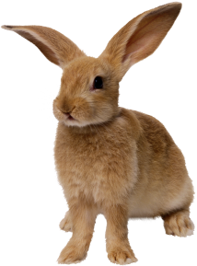
What is the meaning of “significance level”?
It’s the maximum probability we allow for _falsely_ concluding there is a treatment effect (type I error).
You, as the researcher, decide what is acceptable.
Generally, it’s p = 0.05, which is a 1 in 20 chance that you will make a type I error.

Slide 76
App uses significance level of p = 0.05
Low P value (p < 0.05): conclude treatment effect is significant
High P value (p ≥ 0.05): conclude treatment effect is not significant
What can we do to get a smaller P value?
Increase replications! More replications will:
Reduce differences within treatments (error), giving a larger F value, and thus a smaller P value.
Increase the Df of error, giving a smaller P value for a given F value, making it easier to detect differences!
Source of differences | Sum of Squares (SS) | Degrees of freedom (Df) | Mean Sq (MS) | F value | P value (Pr(>F))
Total | 18.102 | 11
Milking practice | 17.129 | 3 | 5.7097 | 46.929
Error | 0.973 | 8 | 0.12517

Slide 77
Finally, what do we conclude based on this ANOVA?
Do we reject or accept H₀ (all treatment means are equal)?
Reject H₀. There is at least one difference among the treatments.
What does this mean in biological terms about our milking experiment?
Milking practice had an effect on milk production in Sahiwal cows at p<0.001.
Which milking practice was best?
We can’t say yet! We’ll use the App to run the mean comparison test, called “Tukey test”
Source of differences | Sum of Squares (SS) | Degrees of freedom (Df) | Mean Sq (MS) | F value | P value (Pr(>F))
Total | 18.102 | 11
Milking practice | 17.129 | 3 | 5.7097 | 46.929 | <0.001
Error | 0.973 | 8 | 0.12517
45.6
<0.001
Notes:
Reject the null because such a low probability that the treatment effect is false (p<0.05 is our significance level). This means that there is at least one difference between the treatments (i.e. there is an effect of milking practice on milk production at p<0.05.)

Slide 78
End of Section 1
At this point, you should have a basic understanding of:
Elements of an experiment
Experimental unit, replication, subsample, independent variable, dependent variable, treatment, factor, randomization
Complete Randomized Design (CRD)
Principles of Analysis of Variance (ANOVA) for a CRD with one treatment
Elements in an ANOVA table for a CRD with one treatment (Sources of variation, Sums of Squares, Mean Squares, F-value, P-value)
Hypothesis testing using F-test
Interpreting p-value in ANOVA table

Slide 79
Section 2 Learning Objectives
Know how to use the App to analyze a CRD
ANOVA, Tukey test
Know how to interpret results and save figures
Formatting and loading CSV file

Slide 80
Agricultural Field Trial Statistics App
App is simple, easy to use, and free (available here: https://github.com/ucd-ipo/aip-analysis/)
Statistical analyses in the App are run using R (available here for Windows: https://cran.r-project.org/bin/windows/base/, and here for Mac: https://cran.r-project.org/bin/macosx/)
We will learn how to:
Format data file and save as .csv file
Load data to App
Experimental setup: experimental design, variable types, dependent and independent variables
Check assumptions of ANOVA, perform transformations if appropriate
Run ANOVA and interpret results
Run mean comparison test, interpret results, and save plots

Slide 81
Agricultural Field Trial Statistics App
App is simple, easy to use, and free (available here: https://github.com/ucd-ipo/aip-analysis/)
Statistical analyses in the App are run using R (available here for Windows: https://cran.r-project.org/bin/windows/base/, and here for Mac: https://cran.r-project.org/bin/macosx/)
We will learn how to:
Format data file and save as .csv file
Load data to App
Experimental setup: experimental design, variable types, dependent and independent variables
Check assumptions of ANOVA, perform transformations if appropriate
Run ANOVA and interpret results
Run mean comparison test, interpret results, and save plots
We will come back to this after using App

Slide 82
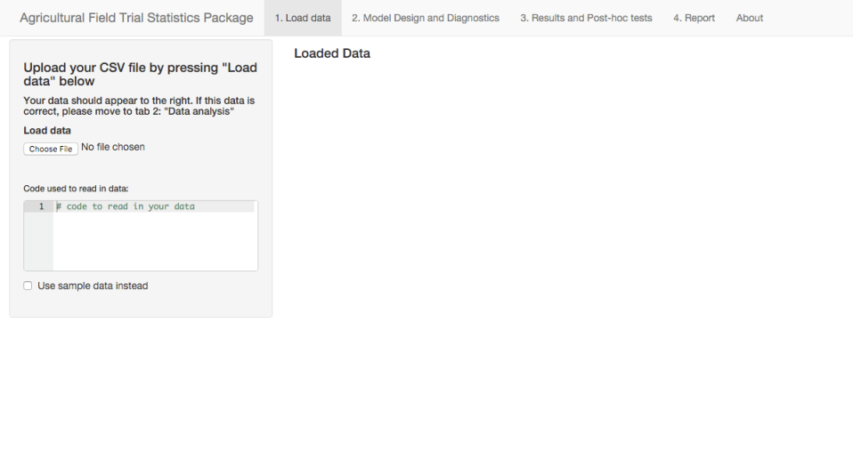
How to load data to App?

Slide 83
1. Click ‘Choose File’ and select your file (it MUST be .CSV file)

Slide 84
1. Click ‘Choose File’ and select your file (it MUST be .CSV file)
Note: Sample datasets for various experimental designs available here. Check the box to see what is available.

Slide 85
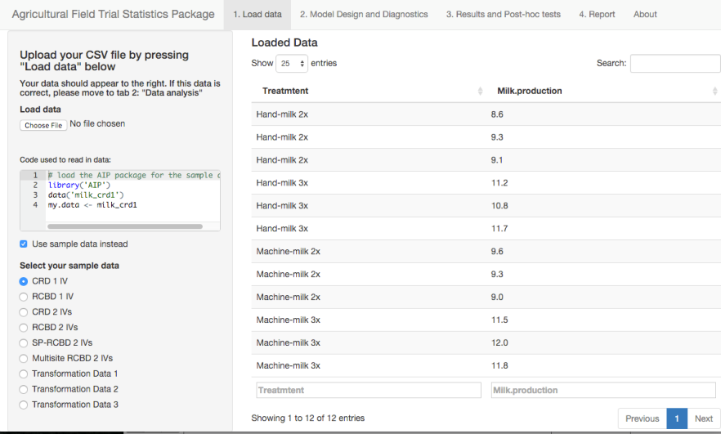
Data are loaded here
The first dataset automatically loads. It’s the milking dataset (‘CRD 1 IV’ = ‘Complete Randomized Design with 1 Independent Variable’)

Slide 86
Here’s the R code that reads your data file.

Slide 87
Agricultural Field Trial Statistics App
App is simple, easy to use, and free (available here: https://github.com/ucd-ipo/aip-analysis/)
Statistical analyses in the App are run using R (available here for Windows: https://cran.r-project.org/bin/windows/base/, and here for Mac: https://cran.r-project.org/bin/macosx/)
We will learn how to:
Format data file and save as .csv file
Load data to App
Experimental setup: experimental design, variable types, dependent and independent variables
Check assumptions of ANOVA, perform transformations if appropriate
Run ANOVA and interpret results
Run mean comparison test, interpret results, and save plots

Slide 88
2. Click ‘Experimental Setup and Assumption Tests’
Notes:
Asked Ian to change title to “Experimental Setup and Assumption Tests”..

Slide 89
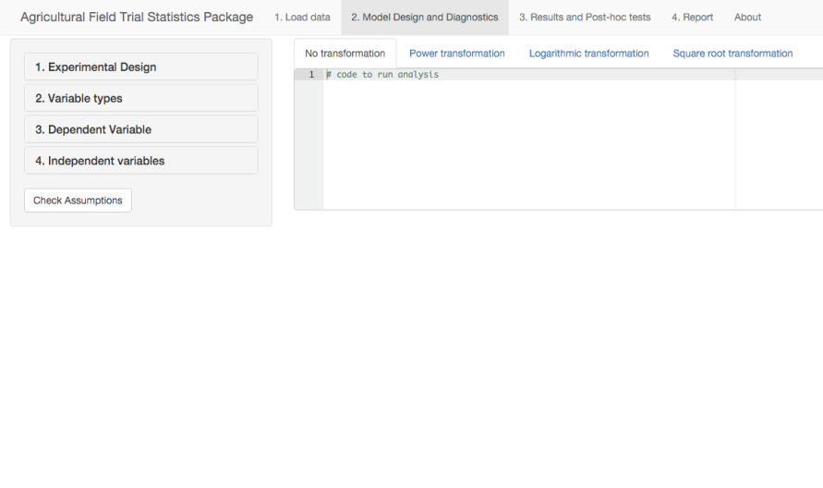
In four steps, you identify your experimental setup and link it to the columns in your data file.

Slide 90
2.1 Click ‘Experimental Design’

Slide 91
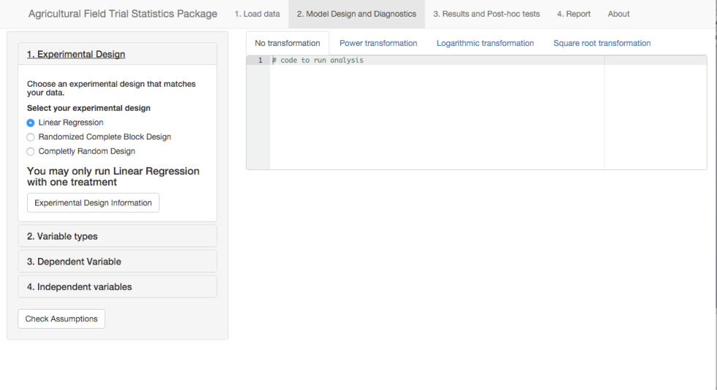
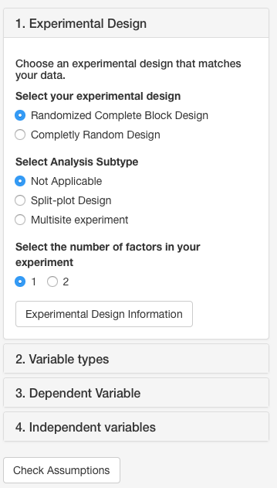
2.1 Click ‘Experimental Design’
Choose your experimental design

Slide 92
2.1 Click ‘Experimental Design’
What is the experimental design of the milking dataset?

Slide 93
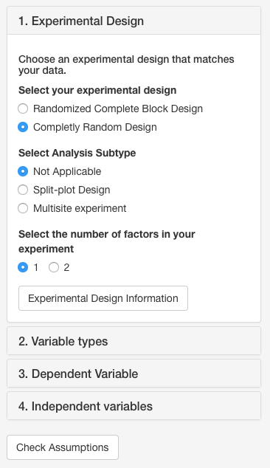
2.1a Click the type of experimental design

Slide 94
2.1b Click an ‘Analysis Subtype’ if applicable
Is there an analysis subtype for the milking dataset?

Slide 95
2.1b Click an ‘Analysis Subtype’ if applicable
Is there an analysis subtype for the milking dataset? No.

Slide 96
2.1c Click the number of factors in your dataset
How many factors are in the milking dataset?
Notes:
Requested Ian to replace “treatments” with “factors”.

Slide 97
2.1c Click the number of factors in your dataset
How many factors are in the milking dataset?
1 = milking practice
Notes:
Requested Ian to replace “treatments” with “factors”.

Slide 98
2.2 Click ‘Variable Types’

Slide 99
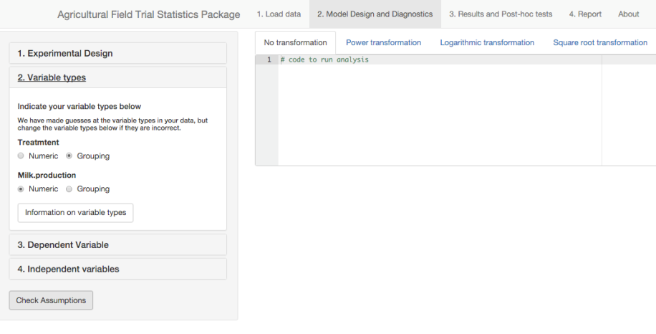
2.2 Click ‘Variable Types’
Titles for each column in your data file (or in Sample Dataset) appear here. Recall that ‘Treatment’ is the type of milking practice (independent variable) and ‘Milk_production’ is the measurement (dependent variable).

Slide 100
2.2a Click ‘Numeric’ or ‘Grouping’ for each variable
‘Numeric’ is a continuous variable. Always choose this for your dependent variable (measurement) .
‘Grouping’ is a factor variable that is repeated multiple times in a dataset Always choose this for your independent variable(s) (e.g. factors, blocks, site).

Slide 101
2.2a Click ‘Numeric’ or ‘Grouping’ for each variable
Is ‘Grouping’ variable correct for ‘Treatment’?

Slide 102
2.2a Click ‘Numeric’ or ‘Grouping’ for each variable
Is ‘Grouping’ variable correct for ‘Treatment’? Yes

Slide 103
2.2a Click ‘Numeric’ or ‘Grouping’ for each variable
Is ‘Numeric’ variable correct for ‘Milk_production’?

Slide 104
2.2a Click ‘Numeric’ or ‘Grouping’ for each variable
Is ‘Numeric’ variable correct for ‘Milk_production’? Yes

Slide 105
2.3 Click ‘Dependent Variable’

Slide 106
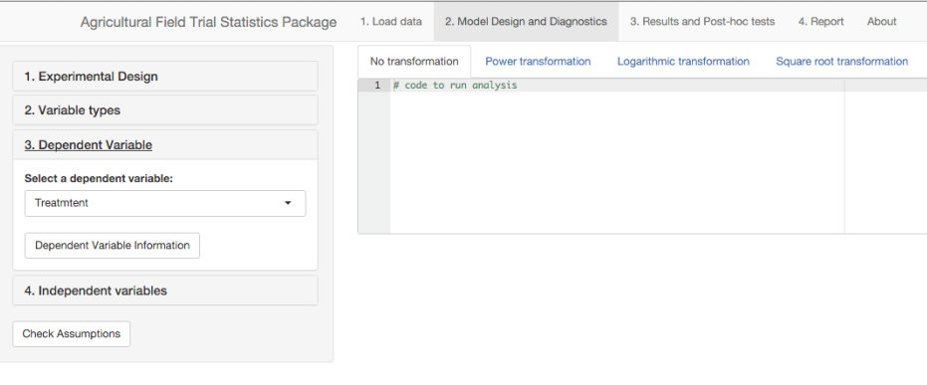
2.3a Click drop-down arrow and choose the dependent variable from the list

Slide 107
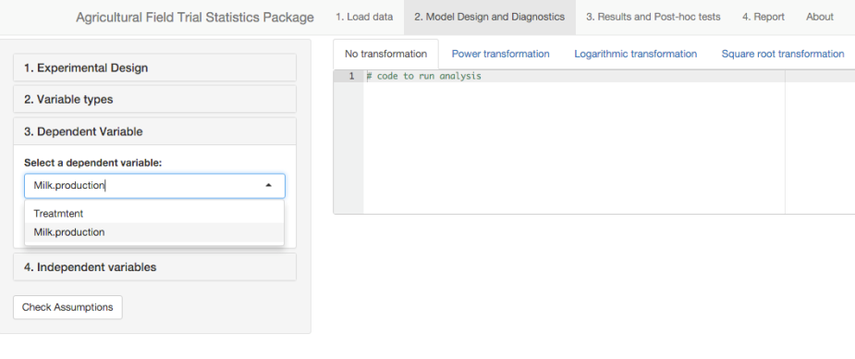
2.3a Click drop-down arrow and choose the dependent variable from the list
Which is the dependent variable?

Slide 108
2.3a Click drop-down arrow and choose the dependent variable from the list
Which is the dependent variable? ‘Milk_production’

Slide 109
2.3a Click drop-down arrow and choose the dependent variable from the list
Which is the dependent variable? ‘Milk_production’

Slide 110
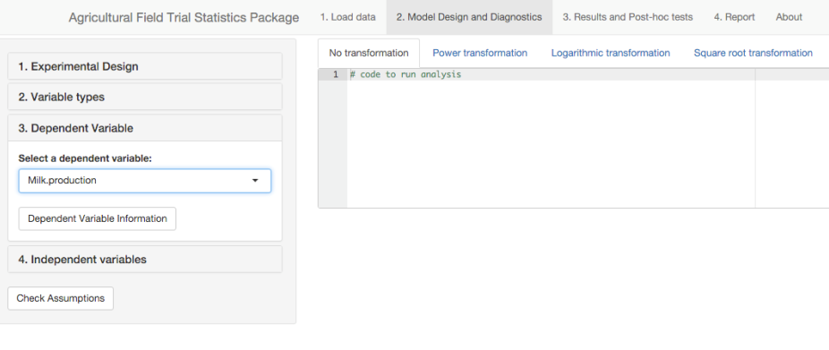
2.4 Click ‘Independent Variable’

Slide 111
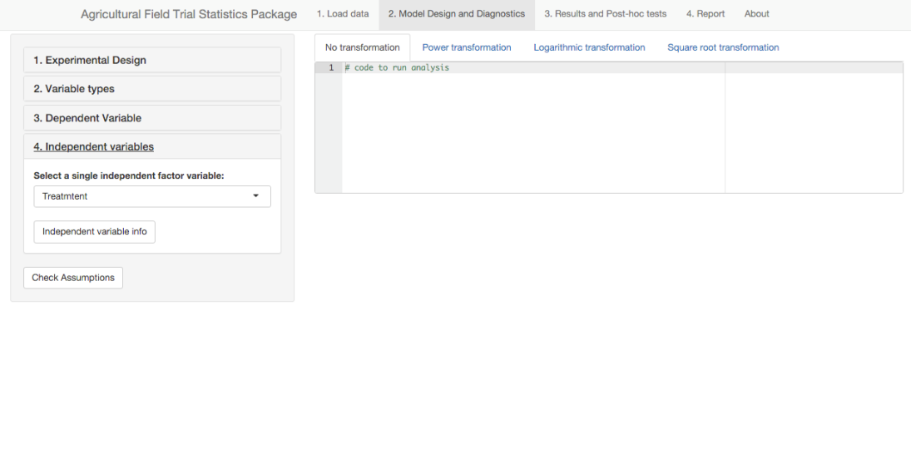
2.4a Click drop-down arrow and choose the independent variable from the list
What is the independent variable?

Slide 112
2.4a Click drop-down arrow and choose the independent variable from the list
What is the independent variable? Treatment

Slide 113
Agricultural Field Trial Statistics App
App is simple, easy to use, and free (available here: https://github.com/ucd-ipo/aip-analysis/)
Statistical analyses in the App are run using R (available here for Windows: https://cran.r-project.org/bin/windows/base/, and here for Mac: https://cran.r-project.org/bin/macosx/)
We will learn how to:
Format data file and save as .csv file
Load data to App
Experimental setup: experimental design, variable types, dependent and independent variables
Check assumptions of ANOVA, perform transformations if appropriate
Run ANOVA and interpret results
Run mean comparison test, interpret results, and save plots
Notes:
Note that the Assumption Tests is a mandatory step in the App for you to see if your data can go straight into ANOVA or if they need to be changed first. we won’t learn about that yet.

Slide 114
2.5 Finally, click ‘Check Assumptions’
Notes:
If you jump to Results tab before checking results, the app won’t work.

Slide 115
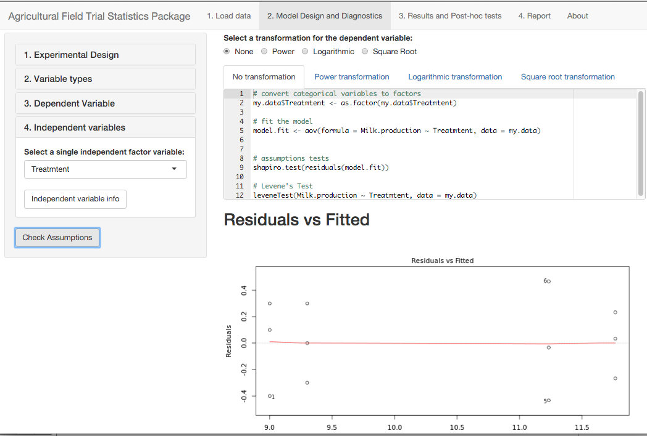
Where are the ANOVA results?

Slide 116
You must Check Assumptions of ANOVA to decide if a transformation is needed before you get ANOVA results

Slide 117
Here is the R code for testing assumptions of ANOVA.

Slide 118
Scroll down to view results of assumption tests and plots.

Slide 119
Assumption tests look good.
(trust me for now)

Slide 120
Assumption tests look good.
No transformation is needed.
Notes:
Should we skip this for now??

Slide 121
‘No transformation’ is the default selection
Notes:
Should we skip this for now??

Slide 122
We will learn how to evaluate assumption tests later.
Notes:
Should we skip this for now??

Slide 123
Agricultural Field Trial Statistics App
App is simple, easy to use, and free (available here: https://github.com/ucd-ipo/aip-analysis/)
Statistical analyses in the App are run using R (available here for Windows: https://cran.r-project.org/bin/windows/base/, and here for Mac: https://cran.r-project.org/bin/macosx/)
We will learn how to:
Format data file and save as .csv file
Load data to App
Experimental setup: experimental design, variable types, dependent and independent variables
Check assumptions of ANOVA, perform transformations if appropriate
Run ANOVA and interpret results
Run mean comparison test, interpret results, and save plots

Slide 124
3. Click Results

Slide 125
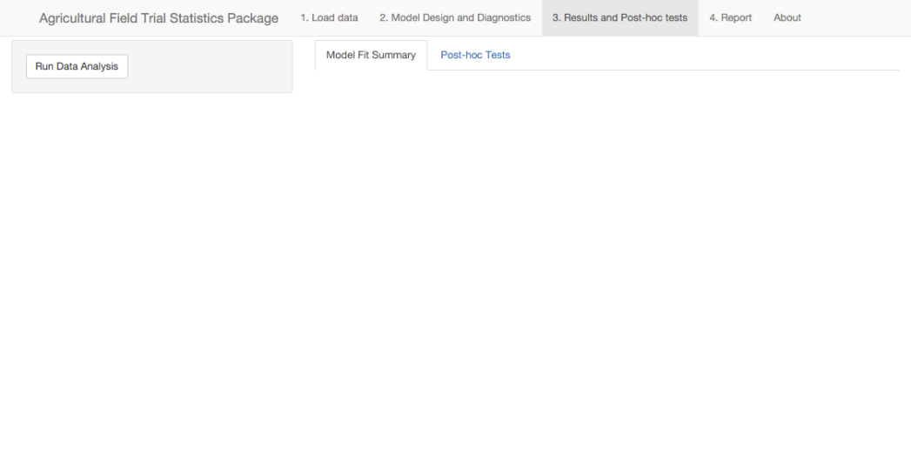
3.1 Click Run Data Analysis

Slide 126
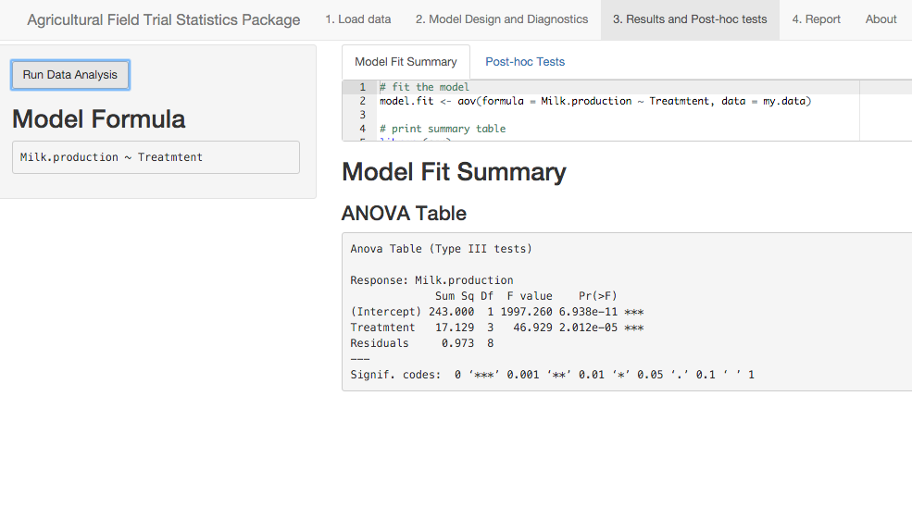
Here is the R code
Here are your ANOVA results!

Slide 127
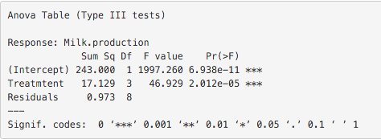
Same as our calculations
ANOVA table Dependent variable = milk production
Source of differences | Sum of Squares (SS) | Degrees of freedom (Df) | Mean Sq (MS) | F value | P value (Pr(>F))
Total | 18.102 | 11
Milking practice | 17.129 | 3 | 5.7097 | 46.929 | <0.001
Error | 0.973 | 8 | 0.12517
⬅ not shown in App
App results

Slide 128
Note the significance level of p-value in App
ANOVA table Dependent variable = milk production
Source of differences | Sum of Squares (SS) | Degrees of freedom (Df) | Mean Sq (MS) | F value | P value (Pr(>F))
Total | 18.102 | 11
Milking practice | 17.129 | 3 | 5.7097 | 46.929 | <0.001
Error | 0.973 | 8 | 0.12517
⬅ not shown in App
*** = Significant at the p<0.001 level

Slide 129
Note the significance level of p-value in App
ANOVA table Dependent variable = milk production
Source of differences | Sum of Squares (SS) | Degrees of freedom (Df) | Mean Sq (MS) | F value | P value (Pr(>F))
Total | 18.102 | 11
Milking practice | 17.129 | 3 | 5.7097 | 46.929 | <0.001
Error | 0.973 | 8 | 0.12517
⬅ not shown in App
Must be at least p<0.05 to be significant in the App

Slide 130
Let’s use the App to find out which was the best milking practice using a mean comparison test.

Slide 131
Agricultural Field Trial Statistics App
App is simple, easy to use, and free (available here: https://github.com/ucd-ipo/aip-analysis/)
Statistical analyses in the App are run using R (available here for Windows: https://cran.r-project.org/bin/windows/base/, and here for Mac: https://cran.r-project.org/bin/macosx/)
We will learn how to:
Format data file and save as .csv file
Load data to App
Experimental setup: experimental design, variable types, dependent and independent variables
Check assumptions of ANOVA, perform transformations if appropriate
Run ANOVA and interpret results
Run mean comparison test, interpret results, and save plots

Slide 132
3.2 Click Mean Comparison Tests & Figures
Notes:
Update with Mean Comparison Test when App is updated.

Slide 133
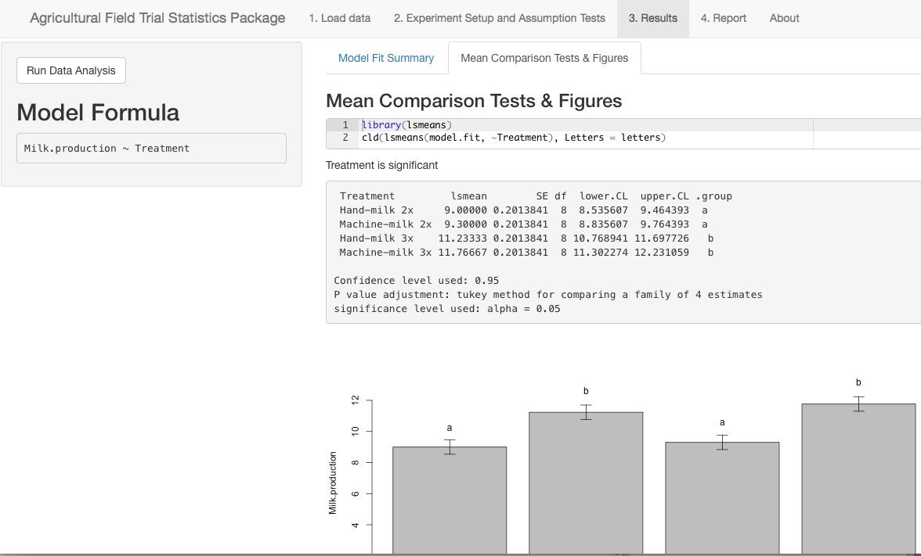
3.2 Click Mean Comparison Tests & Figures

Slide 134
3.2 Click Mean Comparison Tests & Figures
Here is the R code
The test will NOT work if the treatment effect in the ANOVA is not significant.
Tukey test determines which treatments are significantly different at p<0.05.

Slide 135
Here are the results!

Slide 136
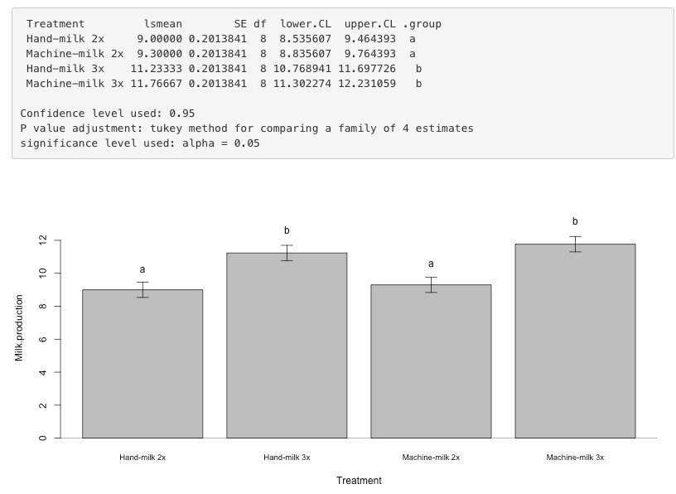
Mean milk production of the four milking practices and their Tukey groupings

Slide 137
How can we save the plot?

Slide 138
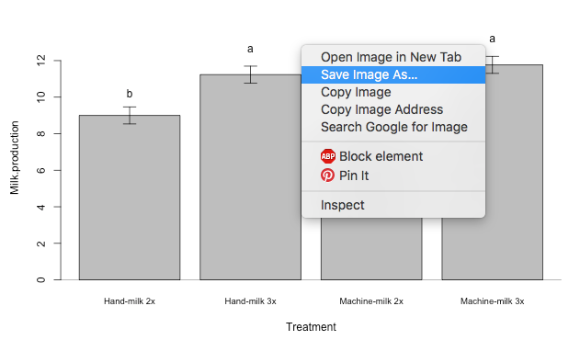
Right-click on the plot and click ‘Save Image As…’ or click ‘Copy Image’ and paste it into a document

Slide 139
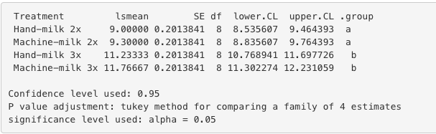
How to interpret Tukey results?
Treatment means with the same letters are not significantly different.
Which is the best treatment?
Notes:
Both machine-milk and hand-milk 3x had higher milk production than 2x per day. However, milk production did not differ by frequency regardless of method.

Slide 140
How to interpret Tukey results?
Treatment means with the same letters are not significantly different.
Which is the best treatment?
Machine- and Hand-milking 3 times per day are the best treatments, compared to 2x per day, as they had greater mean milk production (p <0.05). However, there was no difference between machine- and hand-milking when performed at the same frequency (2x or 3x).

Slide 141
Agricultural Field Trial Statistics App
App is simple, easy to use, and free (available here: https://github.com/ucd-ipo/aip-analysis/)
Statistical analyses in the App are run using R (available here for Windows: https://cran.r-project.org/bin/windows/base/, and here for Mac: https://cran.r-project.org/bin/macosx/)
We will learn how to:
Format data file and save as .csv file
Load data to App
Experimental setup: experimental design, variable types, dependent and independent variables
Check assumptions of ANOVA, perform transformations if appropriate
Run ANOVA and interpret results
Run mean comparison test, interpret results, and save plots

Slide 142
Data must be entered in a program that can save files as comma-separated values (.csv) file
Examples:
Free: Google Sheets (https://docs.google.com/spreadsheets/u/0/)
Cost: Microsoft Excel

Slide 143
How do we format our data files to work correctly with the App?

Slide 144
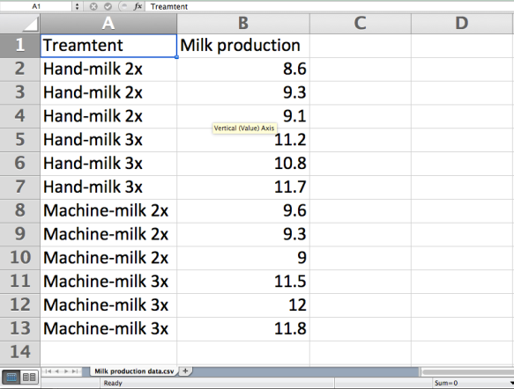
What file needs to look like:
(1) Independent variable (Factor #1)
(2) Dependent variable (Measurement)

Slide 145
What file needs to look like:
(1) Independent variable (Factor #1)
(2) Dependent variable (Measurement)
Titles in first row
Your measurements
Treatments
Notes:
No replication number because that is NOT part of the analysis. Replications only included in split-plot CRD. Blocks always included.

Slide 146
What file needs to look like:
Why are there 3 ‘hand-milk 2x’?
Notes:
No replication number because that is NOT part of the analysis. Replications only included in split-plot CRD. Blocks always included.

Slide 147
Why are there 3 ‘hand-milk 2x’?
3 replications!
Replication | (1) Hand-milk 2x | (2) Hand-milk 3x | (3) Machine-milk 2x | (4) Machine-milk 3x
(1) | 8.6 | 11.2 | 9.6 | 11.5
(2) | 9.3 | 10.8 | 9.3 | 12.0
(3) | 9.1 | 11.7 | 9.0 | 11.8
 | 9.0 | 11.2 | 9.3 | 11.8
3
Treatment means:

Slide 148
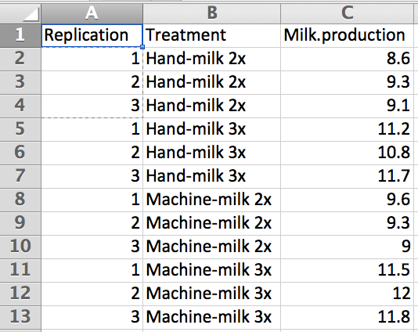
Can we have a “Replication” column?
Notes:
No replication number because that is NOT part of the analysis. Replications only included in split-plot CRD. Blocks always included.

Slide 149
Can we have a “Replication” column?
No. A Replication column is only used in a split-plot CRD (discussed later).
Notes:
No replication number because that is NOT part of the analysis. Replications only included in split-plot CRD. Blocks always included.

Slide 150
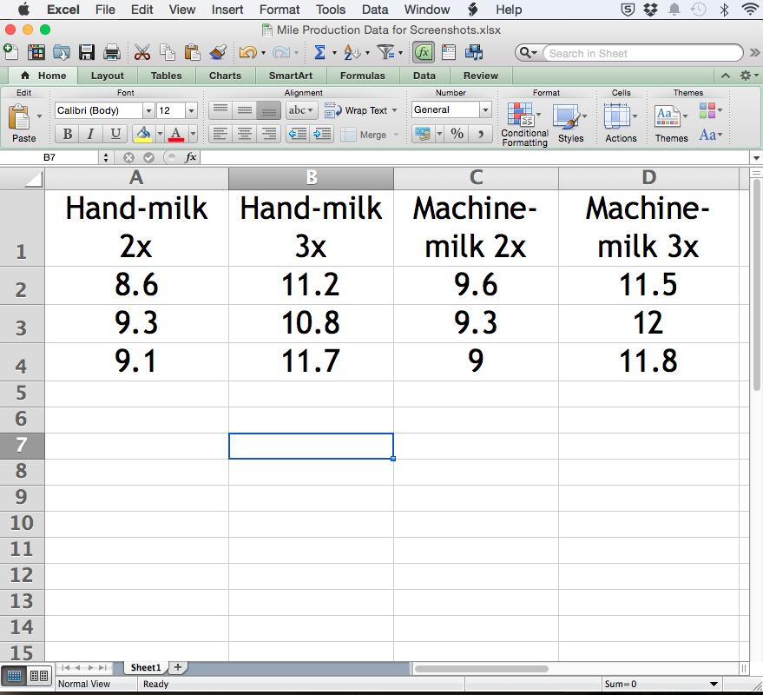
You might have something that looks like this.

Slide 151
This will not work with the App!

Slide 152
Let’s format it correctly.

Slide 153
Four columns

Slide 154
Four rows

Slide 155
Header row shows the titles of each column

Slide 156

Dependent data (measurements) must be cut and paste to ONE column and independent data (treatment levels) in ONE column.
Independent variable = (Factor #1) “milking practice”
Dependent variable = (Measurement) “Milk production”

Slide 157
Independent variable = (Factor #1) “milking practice”
Dependent variable = (Measurement) “Milk production”
Treatment

Slide 158
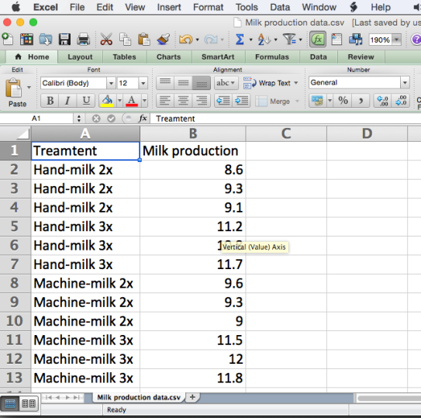
How to save as .csv file in Excel or Google Spreadsheet?
Treatment

Slide 159
First, how to save file as .csv in Excel

Slide 160
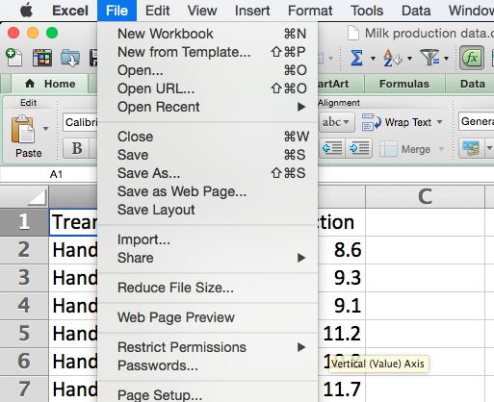
1. Click File

Slide 161
2. Click Save As…

Slide 162
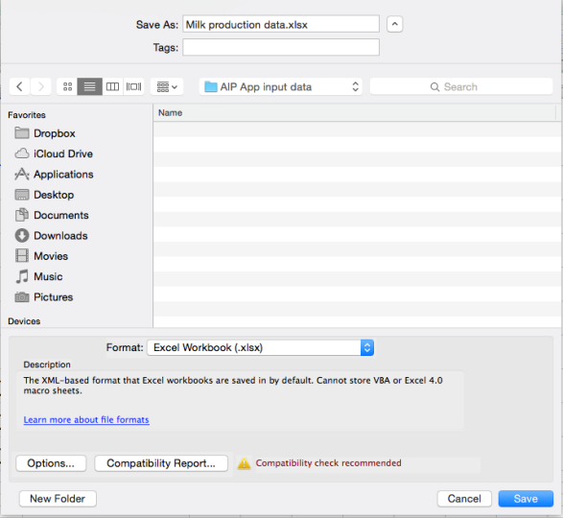
3. Note where you are saving the file. You will need to find it when you use the App.

Slide 163
4. Enter filename

Slide 164

5. Click Format dropdown to select file type

Slide 165
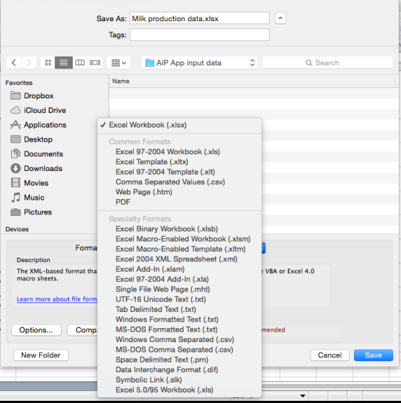
6. Click Windows Comma Separated (.csv)

Slide 166
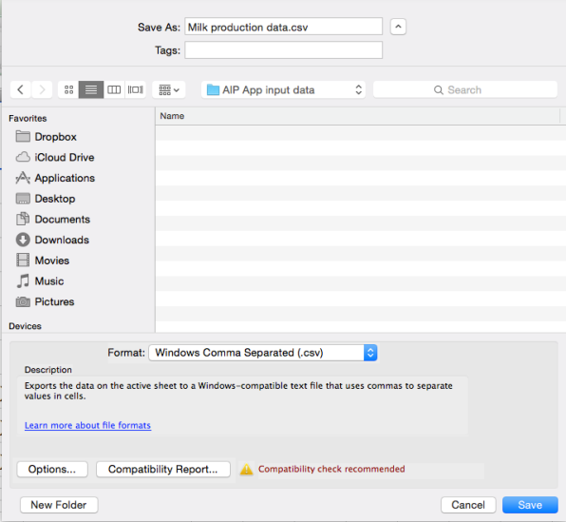
7. Verify that your filename reads .csv

Slide 167
8. Lastly, click Save

Slide 168
Second, how to save file as .csv in Google Sheets

Slide 169
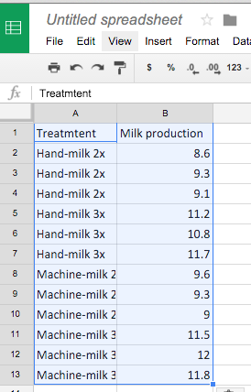
1. Click ‘Untitled spreadsheet’ to change file name

Slide 170
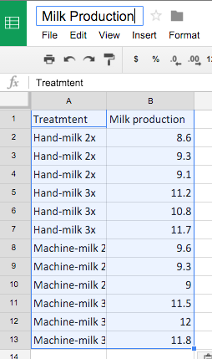
1. Click ‘Untitled spreadsheet’ to change file name

Slide 171
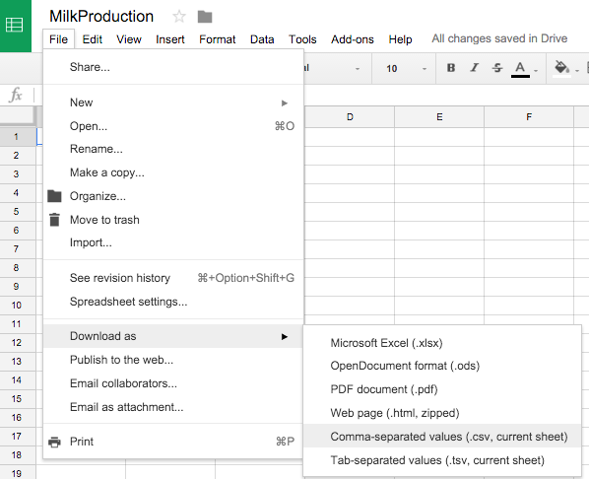
2. Click ‘File’, ‘Download as’, and finally ‘Comma-separated values (.csv)..’
Your file will be saved to the folder designated for web downloads (depends on your computer settings). Generally, it’s called ‘Downloads’.
1
2
3

Slide 172
End of Section 2
At this point, you should be able to:
Use the App to analyze a CRD, including:
Format and load CSV file
Set up data analysis for a CRD with one factor
Run an ANOVA and mean comparison test using Tukey
Interpret results and save plots

Slide 173
Section 3 Learning Objectives
You will gain a basic understanding of:
Randomized Complete Block Design (RCBD)
Reasons to block
How to block and randomize treatments
How to analyze data and interpret results from an RCBD experiment using the App

Slide 174
Research question: Is there a difference in yield among 4 new wheat varieties?
What is the null hypothesis?
H₀: all varieties have equal mean yield
What is the alternative hypothesis?
H_{A}: at least one variety is different than the others
What is the independent variable?
Wheat variety
What is the dependent variable?
Yield

Slide 175
To test H₀ using 4 replications in a field where there is a known gradient in soil nitrogen (shown below), what would you choose as: (1) the experimental design (identify the experimental unit) (2) the spatial layout/orientation of the plots? (3) how would you assign treatments to the plots?
Research question: Is there a difference in yield among 4 new wheat varieties?
Experimental Field
Discuss and draw the plot layout in groups
(low)
(high)
Soil Nitrogen Content

Slide 176
Research question: Is there a difference in yield among 4 new wheat varieties?
1. What is the experimental design and experimental unit?
Randomized Complete Block Design (RCBD) with 4 trts and 4 blocks.
4 trts x 4 blocks =
16 plots
Experimental Field
1 | 2 | 3 | 4
5 | 6 | 7 | 8
9 | 10 | 11 | 12
13 | 14 | 15 | 16
Plots are the experimental units, defined as the “object” that the treatments are applied to.
(low)
(high)
Soil Nitrogen Content

Slide 177
Research question: Is there a difference in yield among 4 new wheat varieties?
Why “block” in this field rather than randomly assign the treatments across all 16 plots as we did for the cows in the CRD ?
Experimental Field
1 | 2 | 3 | 4
5 | 6 | 7 | 8
9 | 10 | 11 | 12
13 | 14 | 15 | 16
We are only interested in the effect of wheat variety on yield, but spatial variation in soil nitrogen affects yield too! Grouping plots with similar soil properties can lower the error (within treatment differences) and make it easier to detect differences among varieties!
Closer plots have more in common than plots further apart (very common in nature). Grouping nearby plots into blocks accounts for this and makes it easier to detect differences between varieties!
(low)
(high)
Soil Nitrogen Content
Notes:
Have participants discuss in pairs, or groups.
First point, is that blocking is important in most field trials due to spatial variability of soil properties. Blocking attempts to group treatments into a location with the most spatially homogenous soil properties so that the primary differences among treatments in a single block is the treatment and not any other environmental condition (spatial autocorrelation is a relationship between locations that depends on their distance apart, i.e. closer points have more in common). We want to reduce variation among our samples due to unknown causes in order to have a greater chance of detecting differences between our treatments. Thus, we can reduce some of the “unknown” or “environmental” variability by grouping/blocking treatments.
Second point, if we know something about the environmental conditions within a field, we can orient blocks accordingly. Another example is a field trial on a hill slope; the blocks would be oriented at the top, middle, and bottom. So that between blocks has the maximum variability.
Third point, treatments are randomized within each block.
Forth point, avoid edge effects.

Slide 178
Complete Randomized Design (CRD):
differences in yield among all plots
differences
between varieties
differences
within varieties
Total yield differences = differences between varieties + error
=
+
Error
Variety
If some of the differences will also be caused by location in the field, use blocking!
Randomized Complete Block Design (RCBD):
Differences among all plots
differences
between varieties
differences
between blocks
=
+
differences
within varieties
+
Error is smaller! What happened?
Error
Note that differences between varieties stays the same.
Some of the error is now accounted for by differences between blocks because blocks differ in soil nitrogen!
Block
Variety
Notes:
Spatial autocorrelation is generally applicable in any field, where points that are closer together have similar environmental properties than points further apart.

Slide 179
Complete Randomized Design (CRD):
differences in yield among all plots
differences
between varieties
differences
within varieties
Total yield differences = differences between varieties + error
=
+
Error
Variety
If some of the differences will also be caused by location in the field, use blocking!
Randomized Complete Block Design (RCBD):
Differences among all plots
differences
between varieties
differences
between blocks
=
+
differences
within varieties
+
Error is smaller! What happened?
Error
Smaller error makes it easier to detect differences due to Variety!
Some of the error is now accounted for by differences between blocks because blocks differ in soil nitrogen!
Block
Variety
Notes:
Spatial autocorrelation is generally applicable in any field, where points that are closer together have similar environmental properties than points further apart.

Slide 180
Research question: Is there a difference in yield among 4 new wheat varieties?
2. How do we arrange the blocks in the field?
Experimental Field
1 | 2 | 3 | 4
5 | 6 | 7 | 8
9 | 10 | 11 | 12
13 | 14 | 15 | 16
(low)
(high)
Soil Nitrogen Content
Notes:
Have participants discuss in pairs, or groups.
First point, is that blocking is important in most field trials due to spatial variability of soil properties. Blocking attempts to group treatments into a location with the most spatially homogenous soil properties so that the primary differences among treatments in a single block is the treatment and not any other environmental condition (spatial autocorrelation = locations in a field that are closer together are more alike than far apart). We want to reduce variation among our samples due to unknown causes in order to have a greater chance of detecting differences between our treatments. Thus, we can reduce some of the “unknown” or “environmental” variability by grouping/blocking treatments.
Second point, if we know something about the environmental conditions within a field, we can orient blocks accordingly. Another example is a field trial on a hill slope; the blocks would be oriented at the top, middle, and bottom. So that between blocks has the maximum variability.
Third point, treatments are randomized within each block.
Forth point, avoid edge effects.

Slide 181
Research question: Is there a difference in yield among 4 new wheat varieties?
2. How do we arrange the blocks in the field?
Experimental Field
Here we’ll group the plots vertically to maximize the differences between blocks.
Block
1
Block
2
Block
3
Block
4
(low)
(high)
Soil Nitrogen Content

Slide 182
3. How are the varieties assigned to the plots?
Research question: Is there a difference in yield among 4 new wheat varieties?
Experimental Field
Block
1
Block
2
Block
3
Block
4
(low)
(high)
Soil Nitrogen Content

Slide 183
Randomly assign the four varieties to plots within each block.
Experimental Field
Block
1
Block
2
Block
3
Block
4
(low)
(high)
Soil Nitrogen Content

Slide 184
Starting with block 1, randomly assign the 4 wheat varieties to the 4 plots.
Experimental Field
Variety ?
Variety ?
Variety ?
Variety ?
Block
2
Block
3
Block
4
(low)
(high)
Soil Nitrogen Content

Slide 185
But how do we do it randomly?
Experimental Field
Variety ?
Variety ?
Variety ?
Variety ?
Block
2
Block
3
Block
4
(low)
(high)
Soil Nitrogen Content

Slide 186
Using a random number generator, or drawing numbers from a hat without replacement. Any other ideas?
Experimental Field
Variety ?
Variety ?
Variety ?
Variety ?
Block
2
Block
3
Block
4
(low)
(high)
Soil Nitrogen Content

Slide 187
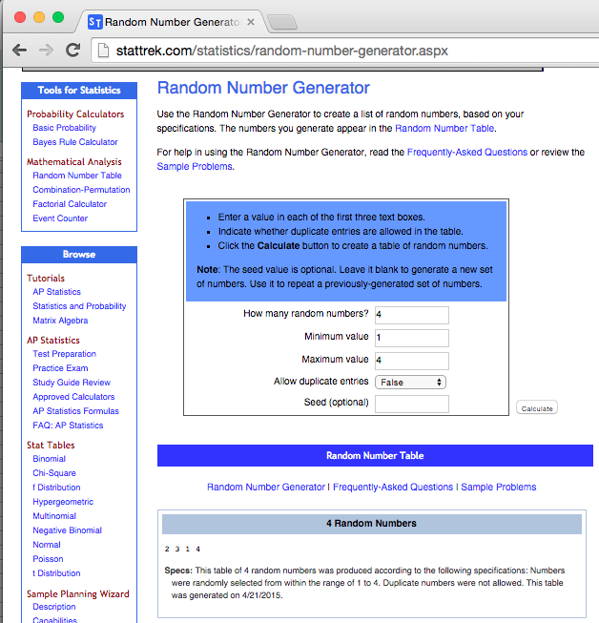
Example of free random number generator online
Enter number of treatments
(4 varieties)
And the min and max values (1 through 4)
Choose “False” for duplicate entries so you only get 1, 2 ,3 and 4 as possibilities.
The order of your treatments for block 1! This time it was
2, 3, 1, 4.

Slide 188
Randomly assign treatments to block 1!
Experimental Field
Variety 2
Variety 3
Variety 1
Variety 4
Block
2
Block
3
Block
4
(low)
(high)
Soil Nitrogen Content

Slide 189
Repeat for each block by refreshing website, or by replacing numbers into hat and drawing them again for each block.
Experimental Field
Variety 2
Variety 3
Variety 1
Variety 4
Block
2
Block
3
Block
4
(low)
(high)
Soil Nitrogen Content

Slide 190
Repeat for each block by refreshing website, or by replacing numbers into hat and drawing them again for each block.
Experimental Field
For example,
Variety 2 | Variety 1 | Variety 3 | Variety 2
Variety 3 | Variety 3 | Variety 4 | Variety 1
Variety 1 | Variety 4 | Variety 1 | Variety 3
Variety 4 | Variety 2 | Variety 2 | Variety 4
(low)
(high)
Soil Nitrogen Content

Slide 191
Our field trial is underway!
Each variety (color) is represented once in each block
Experimental Field
(low)
(high)
Soil Nitrogen Content
Notes:
Have participants discuss in pairs, or groups.
First point, is that blocking is important in most field trials due to spatial variability of soil properties. Blocking attempts to group treatments into a location with the most spatially homogenous soil properties so that the primary differences among treatments in a single block is the treatment and not any other environmental condition (spatial autocorrelation = locations in a field that are closer together are more alike than far apart). We want to reduce variation among our samples due to unknown causes in order to have a greater chance of detecting differences between our treatments. Thus, we can reduce some of the “unknown” or “environmental” variability by grouping/blocking treatments.
Second point, if we know something about the environmental conditions within a field, we can orient blocks accordingly. Thus, treatments within each block have similar soil N levels
Third point, treatments are randomized within each block.
Forth point, avoid edge effects.

Slide 192
Let’s review, when and why do we use a Randomized Complete Block Design (RCBD)?

Slide 193
When?
When the experimental units (e.g. plots, cows) are not uniform, divide them into groups (blocks) that are as uniform as possible.
Examples?
A sloping agricultural field ➔ group plots into an upper block, middle block, and lower block.
Multiple cattle ranches (A, B, C) ➔ group cows by ranch; block A, block B and block C.
Why?
Blocking may reduce the differences within treatments (error), which improves our ability to detect differences between treatments!
Notes:
A CRD assumes that all experimental units are uniform/equal.. if this is not the case, such as in agricultural fields where nearby plants (and soil) are more alike than plants further away, blocking attempts to group experimental units into a space with similar attributes.

Slide 194


Have data. Want analysis.

Slide 195
Exercise 2
In groups, analyze the ‘wheat variety’ dataset using the App:
What are the results?
Is everything OK with it?

Slide 196
Have data. Want analysis.
valid

Slide 197
What are the assumptions of ANOVA? Which ones have you tested before?

Slide 198
We will learn about assumptions of ANOVA and assumption tests using the app in the next section!

Slide 199
Other resources for statistical software:
Free (coding): R (App is powered by this)
Download for Windows: https://cran.r-project.org/bin/windows/base/
Download for Mac:
https://cran.r-project.org/bin/macosx/
Cost (GUIs): JMP, Sigma Plot (graphics)

